Slide 1

Cash and Working Capital Management Forecasting – Guidance on Evaluation and Development of Recommendations on Process
The full scope of Cash and Working Capital Management (CWCM) services is not permissible for SEC audit clients and their affiliates or IFAC PIE audit clients and their related parties. CWCM services are generally permissible for IFAC non-PIE audit clients subject to evaluating engagement circumstances using the conceptual framework (i.e. threats and safeguards approach) and provided we do not assume a management responsibility as outlined in the Global Quality & Risk Management Manual Chapter 11. See detailed guidance regarding Independence on slides 11-16 of the CWCM methodology guide.
RESTRUCTURING
August 2008
ADVISORY
For the purpose of this document, all references to KPMG International, a Swiss cooperative that serves as a coordinating entity for a network of independent member firms operating under the KPMG name, will be referenced as KPMG International. Throughout this document, "KPMG" ["we," "our," and "us"] refers to the local, independent KPMG member firm or firms. Throughout this document “client” [“they,” “their and “them”] refers to the local, independent member firm’s client. KPMG International provides no client services.

Slide 2
Index
Topics Covered Slide Number
Purpose of this document Slide 2
Forecasting Engagement Overview Slide 3
Forecasting Review
Introduction Slide 4
Analyse forecasting process Slide 8
Report current state and recommendations Slide 16
Acronyms Slide 17
Appendix – Reporting examples Slide 18

Slide 3
Purpose of this document
  The purpose of this document is to provide practitioners with guidance on how forecasts can be analysed, and how observations and recommendations to improve the forecasting process can be reported to client management. This guidance is not meant to be comprehensive. This document should be used as a reference tool and lays down guidances that are considered to be leading practices.
  We are regularly asked to comment on cash-flow forecasting processes within businesses. These requests can come from management and/or investors in the businesses e.g., Private Equity houses. The purpose of these requests are to strengthen existing forecasting processes and/or introduce new forecasting processes.

Slide 4
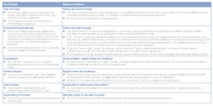
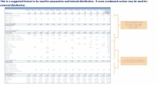
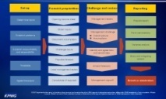
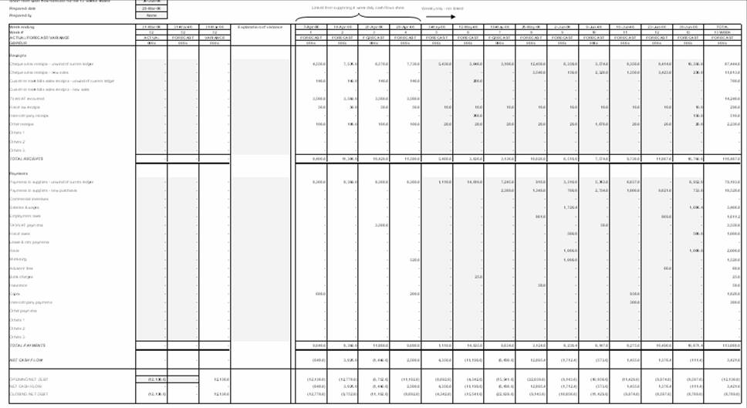
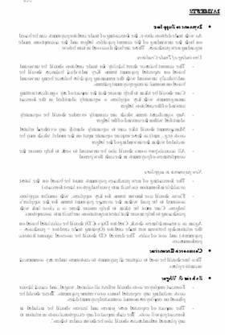
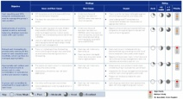
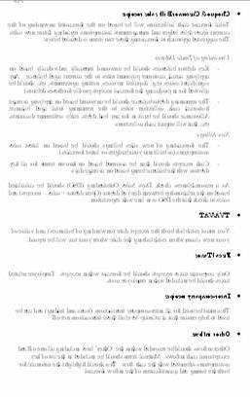
Cash and Working Capital Management for Corporates and PE
Forecasting – Overview
The typical approach during a forecasting – non-crisis engagement can be summarised as follows:
Project kick-off and information request
1
This document covers these areas
Forecasting assessment
2
Evaluation and development of recommendations
Group treasury and review
KPMG experience/ benchmarks
3
Develop revised forecasting process
Current state assessment
4a
Business unit reviews
Group requirements
Business unit involvement
Process design
Revised forecasting process
Forecast roll-out
4b
Pilot entity trial
Re-forecasts
KPMG prior experience
Monitoring and support
Roll out to other businesses
Example Output
Key findings
Case for change
Design layout
Leading practice
Forecasting process
Tools
Instructions

Slide 5
Introduction
  The primary area of focus in this document is around the short-term forecasts where typically companies do not prepare them, or if they do, they are usually not reliable.
  In general, we find that larger companies will usually have the following in place:
    Treasury forecasts
    Long-term cash-flow forecasts
  Mid-market sized companies will usually have some form of short-term forecast (not always receipts and payments basis) and a budget for the current financial year.
  We would recommend process improvements required to improve accuracy and reliability in respect of these forecasts. This would follow the principles of good forecasting set out on slide 6. Assistance and input may also be required from colleagues in Treasury and Financial Management, both in terms of recommendations and implementation.
  Ideally, companies would have three forecasts as follows, which should all reconcile:
Forecast | Length | Rests | Purpose
Treasury forecast | Usually two to four weeks | Daily | Used by Treasury to manage short-term liquidity and in particular investment decisions
Short-term receipts and payments forecast | Usually 13 weeks | Daily or weekly | Used by finance to manage medium-term liquidity and operational performance
Long-term funds flow forecasts | Twelve to twenty four months | Monthly | Used by management for long-term planning and financing decisions

Slide 6
Benefits and principles
  The preparation of a short-term receipts and payments cash-flow forecast will identify for client management:
    Key cash drivers and trends in the business
    Sensitivities and risks
    Potential opportunities to increase headroom
  The potential benefits of a short-term cash-flow forecast include:
    The key drivers of a company’s cash flow and highlights the controls required to deliver the forecast result are identified
    Client management may proactively manage the cash flow as they have visibility of potential issues in advance
    Trends in the business and possible opportunities to drive out headroom are identified
    It is a key element of embedding a cash culture within a business
Principles of a successful cash-flow forecasting process
  Possible key success factors in successful cash-flow forecasting processes are:
    The forecast should be properly set-up e.g., by development of templates, instructions, etc.
    The forecast should be anchored to a balance sheet with further inputs to the cash-flow forecast received from the “owners” of those areas across the business.
    Assumptions should be documented with local and senior management challenge
  Variance analysis of forecast against actual and forecast against reforecast should be undertaken.
  A commentary should be prepared covering key items and assumptions.
  For some line items in a forecast it is sometimes sensible to have a trade-off between 100% accuracy and timeliness of information. For example, the opening cash balance should be accurate, but overhead expenditure could be based on reasonable assumptions rather than perfection.

Slide 7
Project drivers and client requirements
Project drivers
  It is important to understand the drivers behind a cash-forecasting project. Understanding the needs of senior management or other key stakeholders will allow for better communication across the project, such as when discussing the project with content providers/inputters and the forecast compilers.
  Commonly encountered drivers include:
    Need to obtain funding
    Need to reduce non-utilisation fees on facilities
    Need to record visibility over future cash demands. This may be important to:
      Group-level management
      Local-level management
      Lenders
      Private equity owners
    Need to set targets and incentives (especially alongside a cash management/generation programme)
    Need to make announcements to investors
    Need to gain control over overseas entities
    Need to understand cash demands to allow for funds to be identified for growth or investment

Slide 8
Project drivers and client requirements (cont.)
Client requirements
  Once the drivers are understood, it is important to appreciate the requirements of the client so that the output can be tailored to suit client management’s day-to-day requirements. In order to do this, we would usually meet and discuss this with the following people:
    Project sponsor
    Group finance management team
    Group treasury (where applicable) management team
    Key business unit finance and senior management teams
    Key compilers/inputters
  There may be conflicting requirements and demands which will need to be addressed with the project sponsor. These may include:
    Speed versus accuracy of preparation
    Manual versus automation of input/output

Slide 9
Analyse forecasting process
  In undertaking an analysis of cash-flow forecasting within a business, we help the client understand:
    What types of cash-flow forecasts are prepared?
    What is the timing and frequency of such forecasts?
    What is the basis of preparation used in each of the forecasts?
    What instructions and templates are in place to give guidance on preparing those forecasts?
    Who inputs into the preparation of the forecasts?
    What is the historical accuracy of each of the types of cash-flow forecasts prepared?
    Are each type of cash-flow forecasts reconciled?
  Once we have established and understood the above, we are then in a position to comment on whether:
    All cash-flow forecasts that should be prepared are being prepared
    Cash-flow forecasts are truthful
    Forecasting processes are robust

Slide 10
Analyse forecasting process (cont.)
Commonly encountered forecasts
  Below are outlined a number of different types of forecast which have been used by clients in a short term context.
Type of forecast | Description | Comments
Closing balance forecast | Shows only the closing bank balance with no other detail | Not detail to back up the forecast Cannot undertake variance analysis No ownership of line items
EBITDA forecast | Assumes that EBITDA equates to cash flow | Ignores movements in main working capital accounts Ignores irregular/non monthly line items, e.g., quarterly rents, annual prepayments Who is responsible for delivering EBITDA?
Funds flow | Based on a source and application of funds | Better than EBITDA as it includes working capital movements Ownership of line items including operating profit and working capital items is lacking Usually simplistic assumptions used in respect of difficult to forecast line items (e.g., flat prepayments, no movement in stock, flat deferred income) Difficult to understand the drivers of variances
Run rate | Receipts and payments are based on historic run rates | Has some merits in certain circumstances (e.g., high volume of low value transactions, retail sales, smaller value line items) Lacks granularity and it is difficult to understand variance analysis Can create large timing variances as people often take a monthly rate and divide by four Tends not to take into account seasonal fluctuations
Automated/ System generated | Produced as a function of an IT/ accounting system | Depends largely on the quality of data held (e.g., customers’ and suppliers’ payment terms) Assumes everything on ledgers is due and payable. Ignores disputes, customers’ actual payment history, etc. Lack of ownership/responsibility for its production Tends to reflect a theoretical cash position rather than an actual

Slide 11
Analyse forecasting process (cont.)
Forecast review activities
Group and Treasury
review
Business unit
reviews
Benchmarks: Internal
comparisons
Benchmarks: External comparisons
Other KPMG experience
Establish what forecasts are prepared and who uses them
Review historic forecasting accuracy to identify “weak” points
Meet group treasury to review treasury forecasting processes
Meet group finance/ business planning to review planning and forecasting framework and processes
Understand Capital Expenditure (Capex) programme and controls
Establish what group-wide instructions have been issued for each flow forecasting and assess their adequacy
Establish timing and frequency of cash-flow forecasts
Build overall picture of how all cash-flow forecasts are prepared, their accuracy and key forecasting process sensitivities
If needed, meet other relevant group functions (such as sales, purchasing, etc.) and establish their input into the process
Identify key business units for review
  Understand how cash flows around a business through meetings functional heads including:
  Sales
    Purchasing
    Operations
    Inventory management
    Capital Expenditure
    Understand the forecasting process by meeting:
      Principal staff that give input
      Compilers
      Reviewers
  Determine basis or preparation of all cash-flow forecasts prepared
  Establish timing and frequency of cash-flow forecasts
  Establish recent accuracy of cash-flow forecasts
  Assess cash-flow forecasting instructions and assess against better practice
  Identify best and worst performers in terms of accuracy of cash-flow forecasting
  For the best and worst performers, understand the differences between:
    Use of the forecasts
    Basis of preparation
    Who is involved and who inputs into the forecast
    Split of responsibilities
    Challenge and review process
  The above information can be used to feed into the recommendations for improvement
  Consider roll-out of internal better practice
  Compare forecasting process to experience gained working with similar businesses in the same sector and of the same presence and size.
  Identify key differences in the forecast to feed into the recommendations for improvements:
    Use of the forecasts
    Basis or preparation
    Who is involved and inputs to the forecast
    Split of responsibilities
    Challenge and review process
  The above information can be used to feed into the recommendations for improvement.
  Consider the involvement of the following KPMG staff:
    Treasury for Treasury forecast
    Financial Management for long-term forecasts
    Modelling group for complex client models
  These may result in additional costs and early communication to the client as well as internally to help ensure these resources are available.

Slide 12
Analyse forecasting process (cont.)
Forecasting considerations
  The following information provides guidance on the areas typically analysed or considered during a analysis of a forecasting process and whether these aspects are applicable for:
    A treasury forecast
    A short-term cash-flow forecast
    A long-term cash-flow forecast
Developing recommendations
  The points to consider and questions below will assist in identifying weaknesses and gaps in the forecasting processes. Once these have been identified our recommendations can be developed which will enable the weaknesses to be remedied and move the organisation towards our experience of forecasting good practices.
  This will allow a more robust forecasting process to be implemented by the client.

Slide 13
Analyse forecasting process (cont.)
Forecasting considerations
Forecasting considerations
Area | Points to consider | Applies to all | Applicable
 |  |  | Treasury | Short-term | Long-term | Comment
Process | Standardised group wide documented instructions | Y |  |  |  | What checks are there?
 | Consolidation process – automatic | Y |  | ? | ?
 | Consolidation process – manual
 | P&L, Balance sheet, Cash balancing ? |  |  |  | Consistent approach available?
 | Group review, challenge, etc. | Y
People | People closest to data forecasting | Y |  |  |  | If so needs widening out
 | Local review, feedback and adjusting | Y
 | Is it just a finance process
 | Are in-putters identifiable (named) from the output sheets? | Y
 | Is there cross discipline challenge – e.g., cash committee | Y
Distribution | Who receives the output |  |  |  |  | Does it meet user needs?
 | Is there evidence of usage/feedback to compilers |  |  | Y | Y | Accuracy likely to suffer if no feedback
Anchor points | Latest set of bank balances | Y
 | Latest balance sheet |  |  | Latest monthly accounts
 | Forecast balance sheet - reconcile from now to opening |  |  |  | Budgets usually start in a new year before balance sheet known

Slide 14
Analyse forecasting process (cont.)
Forecasting considerations
Forecasting considerations
Area | Points to consider | Applies to all | Applicable
 |  |  | Treasury | Short-term | Long-term | Comment
Cash balances | Is trapped cash separately identified? | Y |  |  |  | May become available Cannot pay wages with trapped cash
 | Are the reasons for it being trapped noted | Y
Documentation | Assumptions documented ? | Y |  |  |  | Aids understanding and reduces questions Allows forecast to be flexed Allows forecast to be flexed
 | Are key risks/sensitivities documented? | Y
 | Are potential upsides documented? | Y
Source data | AR ledger for unwind |  | ? | Y
 | Are non-collectable items excluded |  | ? | Y
 | AP ledger for unwind |  | ? | Y
 | How often are payments made |  | ? | Y
 | Use of order book in forecasting process |  | ? | Y
 | Use of Goods Received Not Invoiced (GRNI) |  | ? | Y
 | Is there a sales/ transaction pipeline? |  | ? | Y
 | Are accruals unwound |  | ? | Y
 | Is WIP unwound? |  | ? | Y
 | Known payment runs Payroll information required |  | Y ? | Y
Submissions | Detailed receipts and payments based |  | Likely | Essential | Unlikely | Net flows mask potential risks Do people read the output Consistency should help completeness
 | Is it just a net flow? |  |  | Often seen
 | How big is the pack? | Y
 | Are entity submissions consistent (content) | Y
Rests | Daily |  | Usual | Possibly
 | Weekly |  |  | Usual
 | Monthly |  |  |  | Usual
Duration | Typical 2-8 weeks daily |  | Y |  |  | Likely to be linked to investing duration Captures quarterly payments Visibility decreases throughout the year
 | 13 weeks typical, possible 17 weeks if updated monthly |  |  | Y
 | Rolling 12 months or just to end of year typical |  |  |  | Seek rolling 12 months/ longer forecasts

Slide 15
Analyse forecasting process (cont.)
Forecasting considerations
Forecasting considerations
Area | Points to consider | Applies to all | Applicable
 |  |  | Treasury | Short-term | Long-term | Comment
Updating | Daily typical |  | Y | Sometimes
 | Weekly/monthly typical |  |  | Y |  | In non-crisis there are cost/benefit considerations
 | Quarterly typical |  |  |  | Y
 | Is the reforecasting process as thorough as the original forecast? |  |  | Y |  | Mid month may not be as thorough
 | Are reforecasts focussed on key items only? |  |  | Y |  | Mid month may not be as thorough
 | Are original forecasts kept or overwritten daily/periodically? | Y |  |  |  | Difficult to track variances if they are overwritten
Variances | Daily typical |  | Y |  |  | Variance analysis drives accuracy
 | Weekly/monthly typical |  |  | Y |  | (as noted elsewhere)
 | Quarterly typical |  |  |  | Y
 | Is there evidence of actions following variance analysis | Y
Funds flows | Typically the product in a medium term forecast |  |  |  | Y | What working capital assumptions have been made
 | These points are also relevant to short-term receipts and payments forecasts |  |  |  | Y | Has there been a sense check of implicit DSO/ DPO/ DIO
 |  |  |  |  | Y | Do assumptions reflect historic seasonal patterns
 |  |  |  |  | Y | Do assumptions reflect changes in the business model
 |  |  |  |  | Y | Do assumptions reflect known business issues
 |  |  |  |  | Y | What financing assumptions have been made
Models |  |  |  |  |  | Is the model integrated fully
 | How complete are the models? Are templates consistent across units? | Y Y |  |  |  | Does the model need IRM (or similar) to review Who built the model?
Reconciliations | Can the three forecasts be reconciled? | Y |  |  |  | Should do this but often is not performed

Slide 16
Analyse forecasting process (cont.)
Forecasting considerations
Forecasting considerations
Area | Points to consider | Applies to all | Applicable
 |  |  | Treasury | Short-term | Long-term | Comment
Run rates | Run rates may be reasonable, but often need checking | Y |  |  |  | Are run rates in evidence?
 |  |  |  |  |  | What are the assumptions?
 |  |  |  |  |  | Are they reasonable given historic cash flows?
Historic actuals | A sense check of historic data to the forecast data should be undertaken | Y |  |  |  | Having obtained actual daily flows:
 |  |  |  |  |  | Do the actuals contain data on more line items than the forecast?
 |  |  |  |  |  | Do the actuals have more frequent flows than the forecast?
"Other" | Does the “other” forecast line item have bigger flows than identified line items? | Y |  |  |  | If so - they should be disaggregated and forecast separately
Excel data | Are the numbers in the forecast hard coded | Y |  |  |  | What is the back up ?
 | Are the numbers summations of several numbers with no explanation | Y |  |  |  | What are the component numbers ?

Slide 17
Report current state and recommendations
  Our findings are typically presented using a report followed by a presentation. The main areas to be covered include:
    Descriptions of cash-flow forecasts prepared
    Overview of cash-flow forecasting processes
    Accuracy of forecasting
    Areas for improvement
    Benchmarking – internal and external
    Recommendation on how to improve cash-flow forecasting and next steps

Slide 18
Acronyms
ABL | Asset Based Lenders
ADD | Average Days Delinquent
AP (A/P) | Accounts Payable
AR (A/R) | Accounts Receivable
BACS | Bank Automated Clearing System
BPDPO | Best Possible Days Payable Outstanding
BPSO | Best Possible Days Sales Outstanding
CAPEX | CAPital EXpenditure
CIS | Contracts Information System
COD | Cash On Delivery
CRA | Credit Rating Agency
CRO | Chief Risk Officer
DAO | Days Accrued Outstanding
DB | Defined Benefit
DC | Defined Contribution
DD | Direct Debit
DIA | Days of Inventory Available
DIH | Days Inventory Held
DIO | Days of Inventory Outstanding
DPO | Days Payable Outstanding
DSO | Days Sales Outstanding
DUO | Days Unbilled Outstanding
EBITDA | Earnings Before Interest, Tax, Depreciation and Amortization
EDI | Electronic Data Interchange
FX | Foreign Exchange
GRNI | Goods Received Not Invoiced
G/L | General Ledger
HMRC | Her Majesty's Revenue and Customs (UK)
LIBOR | London Interbank Offered Rate
NIC | National Insurance Contributions
NPD | New Product Development
PAYE | Pay As You Earn
PE | Private Equity
PPF | Pension Protection Fund
R&D | Research and Development
ROCE | Return On Capital Employed
ROI | Return On Invested Capital
SKU | Stock Keeping Unit
SO | Standing Order
SoC | Schedule of Contributions
STCF | Short Term Cash Flow forecast
VAT | Value Added Tax
VMI | Vendor Managed Inventory
WIP | Work in Progress

Slide 19
Appendix – Reporting Examples
Example outputs from a non-crisis cash-flow forecasting process assessment

Slide 20
Report current state and recommendations (cont.)
Description of cash-flow forecasts prepared
  Three types of cash forecasts are used in large organisations for different purposes. Smaller businesses only uses two of these cash-flow forecasts.
 | 5–10 days |  | 13 weeks |  |  | 1–2 years
Purpose and uses | Treasury management Short-term/overnight investing |  | Used by finance, operations and treasury Driving cash performance Verification of long-term forecast |  |  | Strategic balance planning Facility management
Approach | Daily balance reports Immediate payment runs Forecast daily sales Funds clearing to cash |  | Balance sheet unwind to cash Granular visibility of entity and line item, timing and quantum of flows Future new sales/purchasing Immediate other payments Specific lines for major projects Up to date assumptions Continuously rolled |  |  | Strategic assumptions: Investor requirements Market projections Peer performance Goals, gaps, options, target setting Integrated P&L, B/S, Funds Flow Model Continuously rolled
Company being reviewed | A 45 day treasury forecast is prepared |  | A short-term receipt and payments forecast is not prepared |  |  | A long-term funds flow forecast is prepared
Examples | Retailer | Rolling 26 week daily receipts and payments cash-flow model Updated weekly |  | Top 3 supermarket | Three month budget process Re-forecasts to year end; 3+9, 6+6, 9+3 Considering cutting out 3+9 and 9+3 Treasury forecast daily: one month, largely historic data
 | Global information services | Rolling 18 month, monthly funds flow cash-flow forecast Updated quarterly |  | Global business services | Implemented monthly, country receipts and payments forecasts to year end Submissions from 14 largest countries, centrally consolidated

Slide 21
























Report current state and recommendations (cont.)
Example overview of the cash-flow process
  Forecast cash flows are derived from funds flows following the P&L and balance sheet inputs. There is a wide team involvement in the P&L forecast with the balance sheet preparation primarily managed by finance. A short-term cash Receipts & Payments (R&P) forecast is not used as a check to the funds flow cash forecast. An opportunity exists to replace the existing Treasury forecast with a short-term R&P that could serve this purpose as well as providing treasury information.
Inputs
Commercial team and buyers
Overheads
  Stock loss
  IT
  Regional
Preparation/ Review
FD review
  Head office
  Store costs
  Supply
  Tax
Build other P&L lines
P&L
Submission to Group
Commercial plan
Sales and margin by category (LfL), rebates.
Total sales and margin
Sales and retail profit
Weekly
Commercial
Change plan programme revenue impact model
Actual: Monthly
Finance
Cash flow on funds flow basis
Change plan
  Revamps
  New stores
  Range change
  Pre-opening costs
  Systems
Balance sheet
Upload into HFM
Finance and Development teams estimate phasing
Finance capex schedule
Fixed assets
Stock
Debtors
Cash
Merchandise creditors
Other creditors
Monthly
Property/
change
Monthly
Finance stock forecast
Stock forecast
by category
(flow plan)
Weekly
Supply chain
Merchandise creditors’ schedule
Monthly review session
Other line items
Line by line allocation
Sales forecast
Historic payment trends
Previous month
Known payments
Excel
Excel
45 day inflow/ outflow (daily actual updates)
Treasury forecast
One month
Submit to Group Treasury
Treasury
Daily
Finance
Monthly
Finance

Slide 22
Report current state and recommendations (cont.)
Areas for improvement
  The primary sources of variance in the forecasts are working capital movements and Capex changes.
  Processes are strongly P&L focussed. Cash receives a small proportion of the preparation and review time.
  Most operating companies have significant future Capex plans and are also pursuing other cash consuming strategies.
  Benchmark cash focused businesses have a more integrated approach, use short-term forecasts to drive performance, and use targets and incentives to obtain operational teams thinking about their activities in cash terms.
Observations and external benchmarking | Potential areas for improvement
People Range/depth of involvement of inputters across the organisation’s departments? Are those closest to the forecast input information involved ? Awareness of the cash targets throughout the business? Challenge and review Does the timescale and processes enable a thorough review and challenge of the cash forecast prior to submission? Evidence of cash forecast reviews? Does the review of cash creating action within the operations? P&L Focus Are the businesses and forecasting processes biased towards forecasting the P&L? Is cash a consequence or a balancing figure? Short term and treasury forecasts Are shorter term R&P forecasts used in all businesses? Where they exist who uses them? Process Does each entity employs its own build process? Build Does the process rely on ad hoc MS Excel spreadsheets? Does this cause difficulties in manipulating data or in producing quick updates. Timescale What is the existing budgeting process timeframe? Is it lengthy compared to best practice observed in other businesses? | Using primary sources of information and data Currently cash forecasts are not always prepared with inputs from operational teams closest to the issue and do not always use the best source of data. Switching to the best sources in each business for information on purchases, terms, stock, orders and lead times would enhance accuracy. R&P cash flows Given the increasing priority of cash in the Group and the cash consuming actions being planned across the businesses, driving cash performance is likely to remain high on the agenda. In cash focused businesses short-term R&P forecasts are used across treasury, finance and operations to drive improvements in cash and working capital. Developing a rolling short-term (three month) receipts and payments forecast in key business units could significantly enhance other forecast accuracy while also meeting the needs of treasury. Rolling forecasts Rolling existing forecasts 12 months rather than to year end would assist the budgeting process and give more focus to the first two or three months of the year. Standardised Group instructions, assumptions and tools Developing standard Group instructions and an assumptions framework defining the level of detail and appropriate sources for inputs would improve consistency. Improvements to existing tools in some businesses are advisable. Rolling out a consistent tool set across the Group may not be appropriate in this case.

Slide 23
Report current state and recommendations (cont.)
Example internal benchmarking reporting
Example comments
  Comparison of key aspects of forecasting across the operating companies below shows significant variation.
  The colour coding represents KPMG’s initial views of the strength of each area compared within the Group.
Area |  | Entity 1 | Entity 2 | Entity 3 | Entity 4 | Entity 5
Strategic plan |  | Group process
 | Instructions | None | None | None | None | Some in COGNOS
 | Processes | Comprehensive, lengthy | Comprehensive, lengthy | Comprehensive, lengthy | Comprehensive, lengthy | Comprehensive, lengthy
 | Purpose of cash forecasting | Group reporting | Local facility management | Group reporting | Group reporting | Group reporting/ local facilities
 | Approach | P&L → B/S → cash | P&L → Cash → B/S | P&L → B/S/ Cash | P&L → B/S → cash | P&L → B/S → cash
 | Inputs | Comprehensive for P&L, not for cash | Comprehensive for P&L, not for cash | Comprehensive for P&L, not for cash | Comprehensive for P&L, not for cash | Comprehensive for P&L, not for cash
 | Tools | COGNOS and MS Excel | Plug required | Complex MS Excel | Complex MS Excel | COGNOS
Forecast duration |  | To year end
Treasury – R&P forecast |  | 45 days | Internal | Monthly rolling plan and 1 month daily | No longer used | Not seen
Cash and working capital targets |  | Flowed down | Senior level | Next year | Senior level | Unclear
Local review |  | Multi stage review and challenge process
Group challenge and management action |  | Medium | Medium | Currently high | Medium | Unclear
Colour coding key |  |  |  | Good practice | Practice can be improved | Poor practice
Cash as part of budgeting and forecasting
Example

Slide 24
Report current state and recommendations (cont.)
Example external benchmarking reporting
Example comment
  The company approach to cash forecasting is typical of many large corporates and non-PE owned businesses which have been growing, successful and largely P&L focused.
Area |  | Better practice | Company being reviewed
Strategic plan |  | Strategic plans used to drive targets | Yes
 | Instructions | Standardised cashflow instructions and processes limit dead time and provide clarity over approach | No instructions for cash-flow forecast
 | Processes | Budget timescale ranges from under two months to average two to four months Integrated with five year plans | Up to six months
 | Users | Board, Finance/Control, Tax, HR, Treasury One budget able to be cut for many needs | Separated treasury and business performance
 | Approach | Focused on key drivers 40-50 line items – not 1,000s | Very detailed in some businesses
 | Inputs | Direct from source especially for shorter term | Mixed
 | Tools | Single data sets/models Models easy to manipulate for changes Push button recalculations | Complex Excel models
Forecast duration |  | 12 months Rolled further three months each quarter | Year end
Treasury – R&P forecast |  | Strong interconnection with Treasury forecast Reconciliations at month/quarter ends | No connection
Cash and working capital targets |  | Regular (monthly/quarterly) targets | Year end cash target
Incentives/measurement |  | Incentives based on targets – regularly tested | Early stage, not flowed down
Review and management |  | CEO/ Managing Director/commercial involvement Risks and opportunities reporting Forward looking | Limited review and action created Analysts sit between company and operating company in the process
Budgeting and forecasting
Example

Slide 25
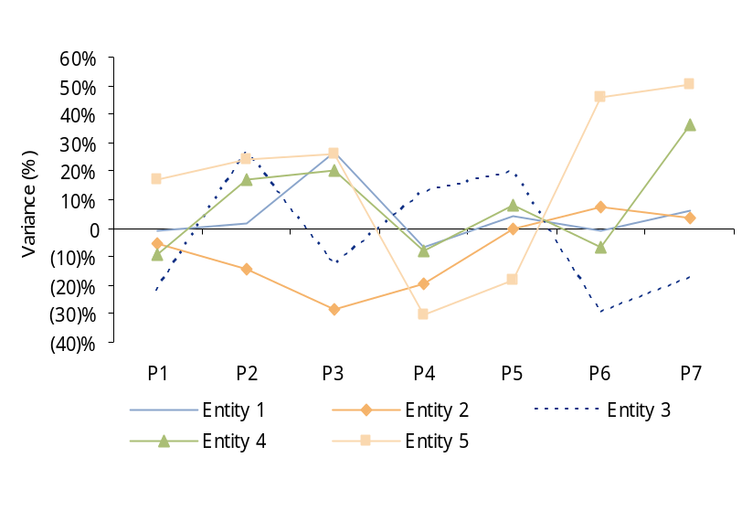
Report current state and recommendations (cont.)
Potential reporting contents – accuracy of forecasting
Example reporting
Monthly variance of cash flow in the long-term cash-flow forecast as a percentage of turnover (%)
Forecast accuracy
% | Cumulative variance as a percentage of turnover | Cumulative variance as a percentage of forecasted cash flow
Entity 1 | 12% | 44%
Entity 2 | 8% | 64%
Entity 3 | 20% | 72%
Entity4 | 32% | 89%
Entity 5 | 16% | 111%
Note: The ranking has been based on absolute monthly cumulative variances (to XXX) as a percentage of the budgeted/ forecasted cash and turnover. Source: Cash flow variance report 2007
Sources of variance
Ranking | Entity 1 | Entity 2 | Entity 3 | Entity 4 | Entity 5
1 | Creditors | Creditors | Creditors | Creditors | Creditors
2 | Stock | Stock | Stock | Stock | Capex
3 | Debtors | Debtors | Debtors | Debtors | Debtors
4 | Capex | Capex | Capex | Capex | Stock
5 | Operating profit | Sale of assets | Operating profit | Operating profit | Payments for investments
Note: Ranking based on an absolute basis and not as a percentage of underlying balance. Source: Cash flow variance report 2007
Example
Source: Cash flow variance report, management information 2007
The main causes of variances are within working capital and capital expenditure. There are no specific patterns in the variances.
  Example comments
  A review of the accuracy of the long-term cash-flow forecasts produced since the start of the financial year has shown a high degree of variance between actual and budget or latest forecast positions.
  The actual cash balance does not consistently out-perform or under-perform the forecast which indicates general inaccuracy rather than consistently prudent or aggressive assumptions.

